Slide 1
Functions in C
By: Nida munawar

Slide 2
Functions
Most computer programs that solve real-world problems are much larger than the programs presented in the first few chapters.
Experience has shown that the best way to develop and maintain a large program is to construct it from smaller pieces or modules, each of which is more manageable than the original program.
This technique is called divide and conquer.
Modules in C are called functions.
A larger program is created by developing smaller components individually and then assembling them together as whole.
A function is a group of statements that together perform a task.
Every C program has at least one function, which is main().

Slide 3
Types of Functions
Depending on whether a function is defined by the user or already included in C compilers,
There are two types of functions in C programming:
Standard library functions
User defined functions

Slide 4
Types of Functions [Cont.]
Standard library functions:
The C standard library provides a rich collection of functions for performing common mathematical calculations, string manipulations, character manipulations, input/output, and many other useful operations. These functions are also called as user defined functions.
These functions are defined in the header file. When you include the header file, these functions are available for use. For example:
The printf() is a standard library function to send formatted output to the screen (display output on the screen). This function is defined in "stdio.h" header file. There are other numerous library functions defined under "stdio.h", such as scanf(), fprintf(), getchar() etc. Once you include "stdio.h" in your program, all these functions are available for use.

Slide 5
Types of Functions [Cont.]
User-defined functions
As mentioned earlier, C allows programmers to define functions.
Depending upon the complexity and requirement of the program, we can create as many user-defined functions as we want.
Because C does not provide every function that we will ever need, we must learn to write own functions.
For example, there is no any function in C that finds the maximum number out of an array or swap two variables with each other.
For these tasks we need to create our own (user-defined) functions.

Slide 6
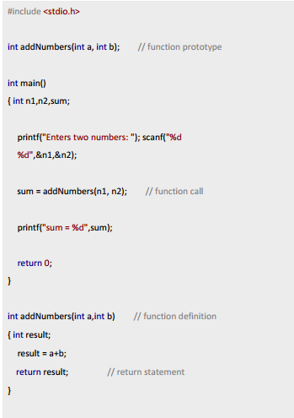
Types of Functions [Cont.]
Example: User-defined function
Here is an example to add two integers. To perform this task, a user-defined
function addNumbers() is defined.

Slide 7
Why Functions
We decompose a program into functions for several reasons:
It provides modularity to your program's structure.
It makes your code reusable. You just have to call the function by its name to use it, wherever required.
In case of large programs with thousands of code lines, debugging and editing becomes easier if you use functions.
It makes the program more readable and easy to understand.

Slide 8
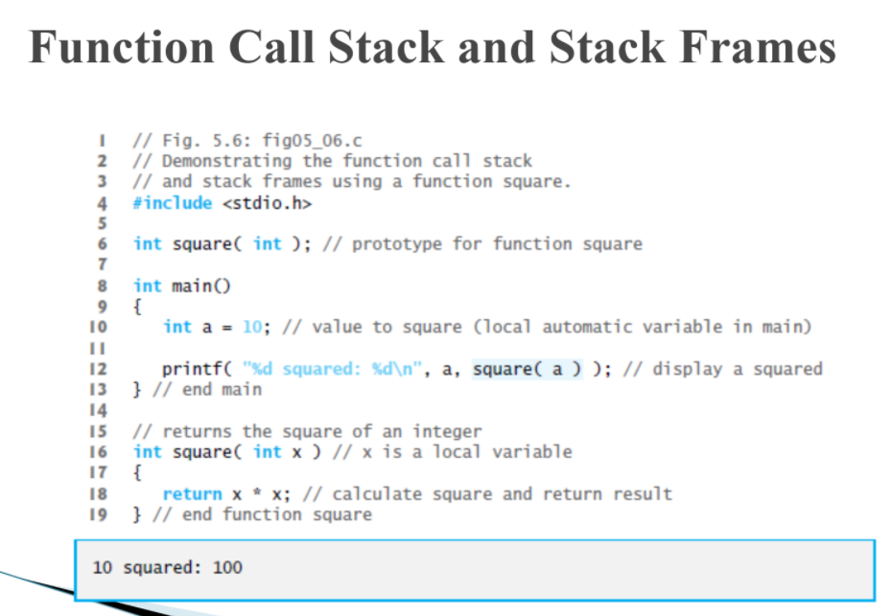

Slide 9
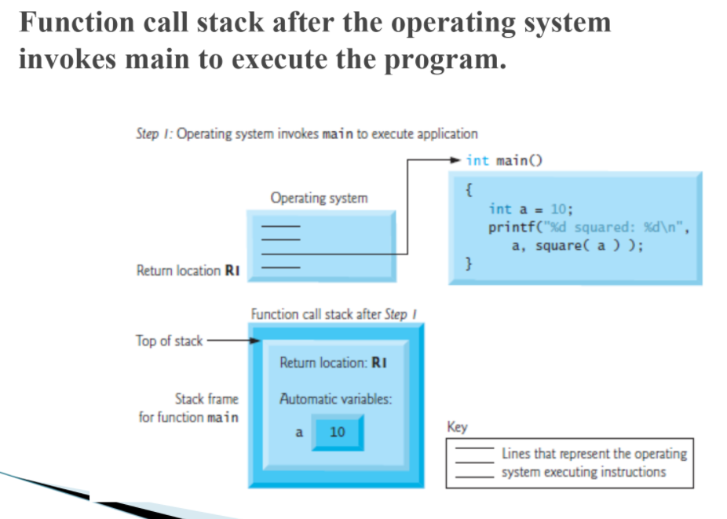

Slide 10
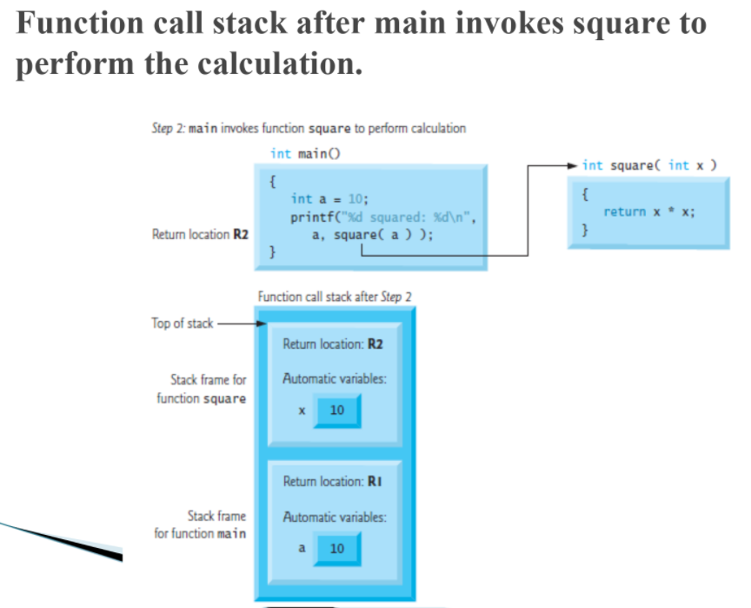

Slide 11
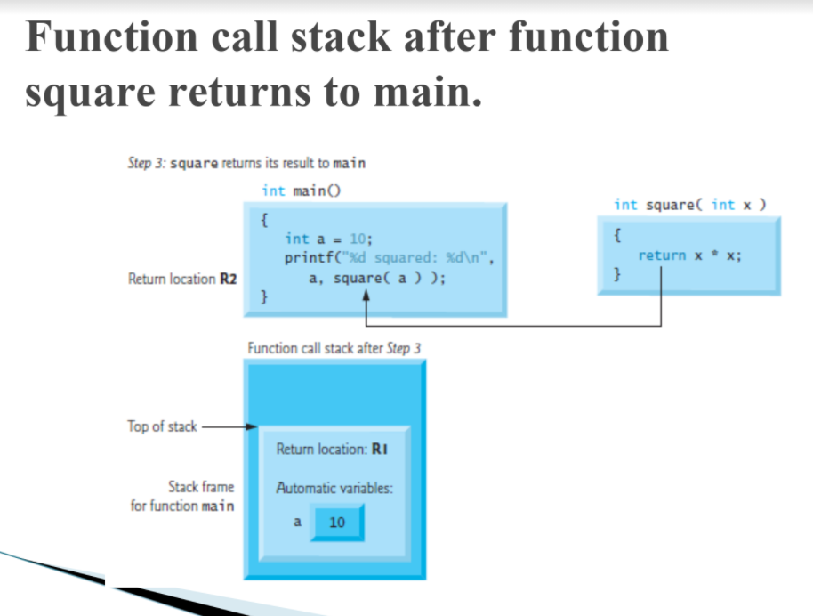

Slide 12
Anatomy of Function
Function prototype
A function prototype is simply the declaration of a function that specifies function's name, parameters and return type.
It doesn't contain function body.
A function prototype gives information to the compiler that the function may later be used in the program.

Slide 13
Anatomy of Function [Cont.]
Syntax of function prototype
returnType functionName(type1 argument1, type2 argument2,...);
In the above example, int addNumbers(int a, int b); is the function prototype which provides following information to the compiler:
1. name of the function is addNumbers()
2. return type of the function is int
3. two arguments of type int are passed to the function
The function prototype is not needed if the user-defined function is defined before the main() function.

Slide 14
Anatomy of Function [Cont.]
Calling a function
Control of the program is transferred to the user-defined function by calling it.
Syntax of function call
functionName(argument1, argument2, ...);
In the above example, function call is made using addNumbers(n1,n2); statement inside the main().

Slide 15
Function Calls
Call by value
Copy of argument passed to function
Changes in function do not effect original
Use when function does not need to modify argument
Avoids accidental changes
Call by reference
Passes original argument
Changes in function effect original
Only used with trusted functions

Slide 16
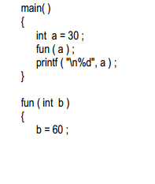
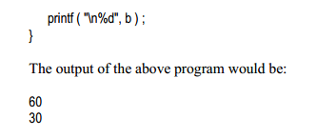
Function Calls
Call by value

Slide 17
Anatomy of Function [Cont.]
Function definition
Function definition contains the block of code to perform a specific task i.e. in this case, adding two numbers and returning it.
Syntax of function definition
returnType functionName(type1 argument1, type2 argument2, ...)
{
//body of the function
}

Slide 18
Anatomy of Function [Cont.]
When a function is called, the control of the program is transferred to the function definition. And, the compiler starts executing the codes inside the body of a function.

Slide 19
Types:
No return and no parameter(s)
No return but take parameter(s)
Return some thing but no parameter(s)
Return some thing as well as take parameter(s)

Slide 20
Function argument passing
Passing arguments to a function
In programming, argument refers to the variable passed to the function. In the above example, two variables n1 and n2 are passed during function call.
The parameters a and b accepts the passed arguments in the function definition. These arguments are called formal parameters of the function.

Slide 21
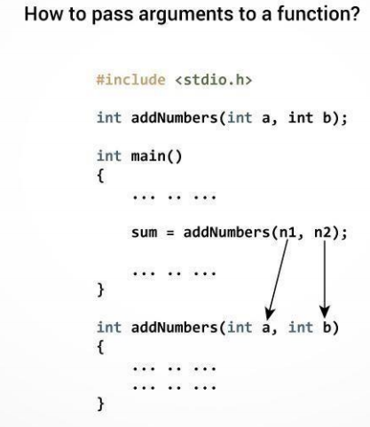

Slide 22
Passing arguments
The type of arguments passed to a function and the formal parameters must match, otherwise the compiler throws error.
If n1 is of char type, a also should be of char type. If n2 is of float type, variable b also should be of float type.
A function can also be called without passing an argument.

Slide 23
Return Statement
The return statement terminates the execution of a function and returns a value to the calling function. The program control is transferred to the calling function after return statement.
In the above example, the value of variable result is returned to the variable sum in the main() function.
Syntax of return statement
return (expression);

Slide 24
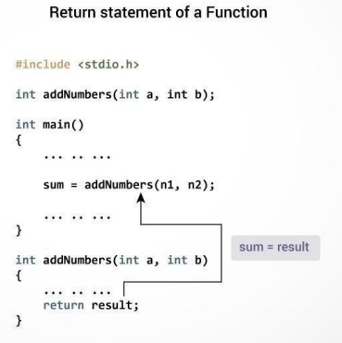
Return Statement [Cont.]

Slide 25
Scope Rules
The scope of an identifier is the portion of the program in which the identifier can be referenced.
The four identifier scopes are:
function scope,
file scope,
block scope, and
function-prototype scope.
Local variables declared as static retain their values even when they’re out of scope.

Slide 26
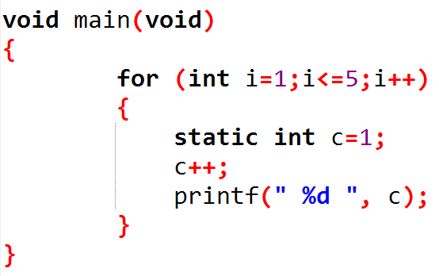
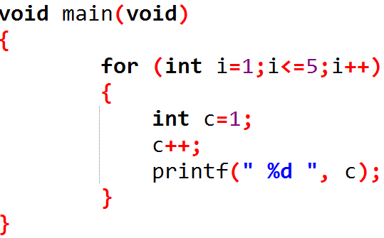
What are the outputs?

Slide 27
Storage class
A storage class defines the scope (visibility) and life-time of variables and/or functions within a C Program.
The static Storage Class
The static storage class instructs the compiler to keep a local variable in existence during the life-time of the program instead of creating and destroying it each time it comes into and goes out of scope. Therefore, making local variables static allows them to maintain their values between function calls.
The static modifier may also be applied to global variables. When this is done, it causes that variable's scope to be restricted to the file in which it is declared.
In C programming, when static is used on a global variable, it causes only one copy of that member to be shared by all the objects of its class.

Slide 28
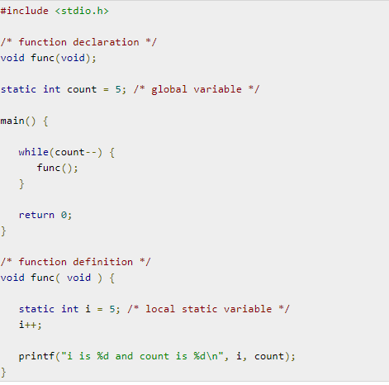
Storage class

Slide 29
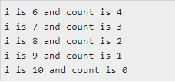
Storage class

Slide 30
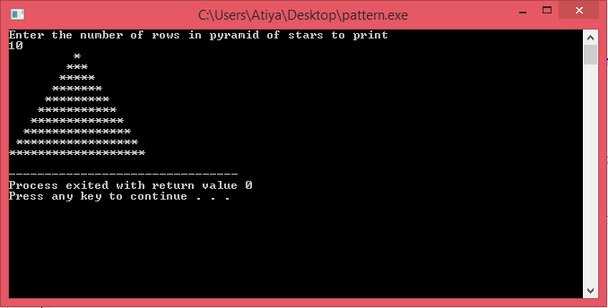
TASK: Generate following pattern using nested loops and functions

